Slide 1



Creating A RAM Backed, Dynamically Compressed Swap Device Driver
Systems Capstone
December 16, 2019

Slide 2
Background and Motivation

Slide 3

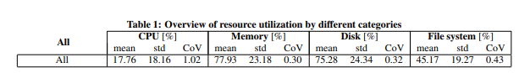
RAM is A Precious Resource
In data centers, physical memory is scarce
In general, it seems if an application designer has more physical memory, they will use it
i.e. sparse matrices, calloc’ed arrays, doubles
Data centers use up their memory more often than their total CPU.
Birke, R., Chen, L. Y., & Smirni, E. (2012). Data centers in the wild: A large performance study. Technical Repo, (Z1204-002).

Slide 4
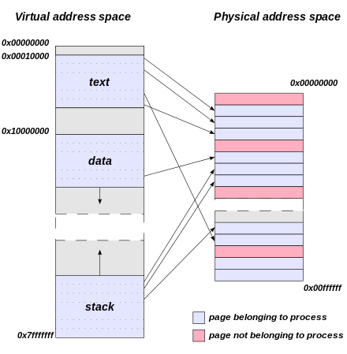
The memory model
All memory is backed by 4096 byte pages.
This is a standard kept for decades
Linux uses a page table, which maps virtual addresses ⬄ physical addresses
When a page is accessed, the kernel moves it to physical memory
i.e., read/write array values, modify struct
https://kb.iu.edu/d/aagb

Slide 5
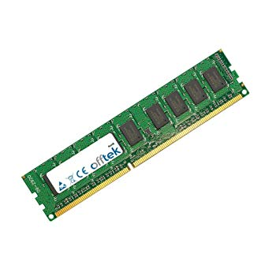

What Happens When You Run Out of Memory?
Kernel will not permit you to allocate past physical memory limit, OR
Kernel uses a swap file:
A swap file is typically a section of hard disk reserved to act as overflow memory.
Idle programs’ memory get “swapped” when memory is needed.
The kernel keeps track of this in a page table
Doing this is COSTLY, so always avoid swapping if possible…
https://kb.iu.edu/d/aagb

Slide 6
Memory Latency (ns)
A Comparison of Memory Latency in nanoseconds
https://people.eecs.berkeley.edu/~rcs/research/interactive_latency.html

Slide 7
Memory Speed (ns)
Speed of Sequentially Reading 1 MB from different sources in nanoseconds
https://people.eecs.berkeley.edu/~rcs/research/interactive_latency.html

Slide 8
Swap Downsides
Latency:
SSD ~ 160x Slower than RAM
Hard Disk ~ 30,000 Slower than RAM
Sequential Read Speed (1 MB)
SSD ~ 15x Slower than RAM
Hard Disk ~ 236x Slower than RAM
With a Swap file we gain more memory but take a big hit to performance when swapping to/from Swap file.

Slide 9

TL;DR: Reading/Writing to Swap incurs a large performance hit.
Solution: Find a way to stay in main memory as much as we can.
RAM Backed, Dynamically Compressed Swap Device Driver

Slide 10
01
Let’s Break That Down

Slide 11
RAM Backed
Lives in Main Memory

Slide 12
Dynamically Compressed
Compress and decompress data on the fly

Slide 13
Swap Device Driver
Create a Block Device Driver and use it solely for Swap

Slide 14
Our Solution
If memory is full and swap has bad performance, how do we get more memory?
Compression!
Create a new device and driver that lives in RAM and acts as a Swap file.
OS thinks its swapping a page out to our device, but it will always still be in memory.

Slide 15
Our Solution (2)
Optimally done in page.h. Done in device driver form for demonstration purposes.
We “Reserve” part of memory for our device.
Device has an uncompressed portion and a compressed portion.
Once the uncompressed section hits a threshold, we compress a portion and store in the compressed section.

Slide 16
Starting to Fill Uncompressed

Slide 17
Uncompressed Full

Slide 18
Flush Portion of Uncompressed to Compressed
25 MB Used
50 MB Free

Slide 19
Design

Slide 20
Device Struct Highlights
Mapping array and reverse mapping array
High/low watermarks
Size compressed/uncompressed
Used compressed/used uncompressed bytes
Compressed_data array
Uncompressed_data array

Slide 21
Uncompressed_Data
Vmalloced a chunk of memory.
Treat it as a circular array.
We store in chunks of 4096 bytes.
Procedure to Write/Read:
Get a sector from the kernel, check our mapping array.
Go to the offset in the mapping array and Read/Write the next 4096 bytes.

Slide 22
Compressed_Data
Vmalloced another chunk of memory.
Also treated as a linked list.
124 Bytes Data + 4 Byte Next Pointer
Store block offset as negative number in mapping array (to signal compressed)
To write, we get data from the uncompressed. We compress the data and then distribute amongst blocks.
To read, we get the compressed data, decompress it, then put it into the uncompressed portion.

Slide 23
Compression Scheme
Run Length Encoding (RLE) used for encoding.
Implemented as a ram module run along side our device.
Takes AAABBCCCC into 3A2B4C
Call rle() and unrle() to compress and decompress.
If compressed size > uncompressed size, leave uncompressed.

Slide 24
Quick Walk-Through

Slide 25
Uncompressed and Compressed Empty
Write to the uncompressed array with page data, fill in mapping array.
We hit the high watermark.
Starting from the oldest page, for each page until we hit the low watermark we remove from uncompressed portion, compress the page, add it to the compressed portion and update the mapping.

Slide 26
Uncompressed and Compressed Both Partially Filled
Read/Write to uncompressed strait forward.
Read from compressed: decompress, put back in uncompressed portion, and read.
Write to compressed: remove the compressed data from the compressed portion and write to the uncompressed array. Update mappings.

Slide 27
Controlled Testing/Benchmarking:
Procedure: Calloc() until memory is full.
We mlock() this data to make sure it stays in memory
We then calloc() test data (which is then paged out to swap
Measure Swap data

Slide 28
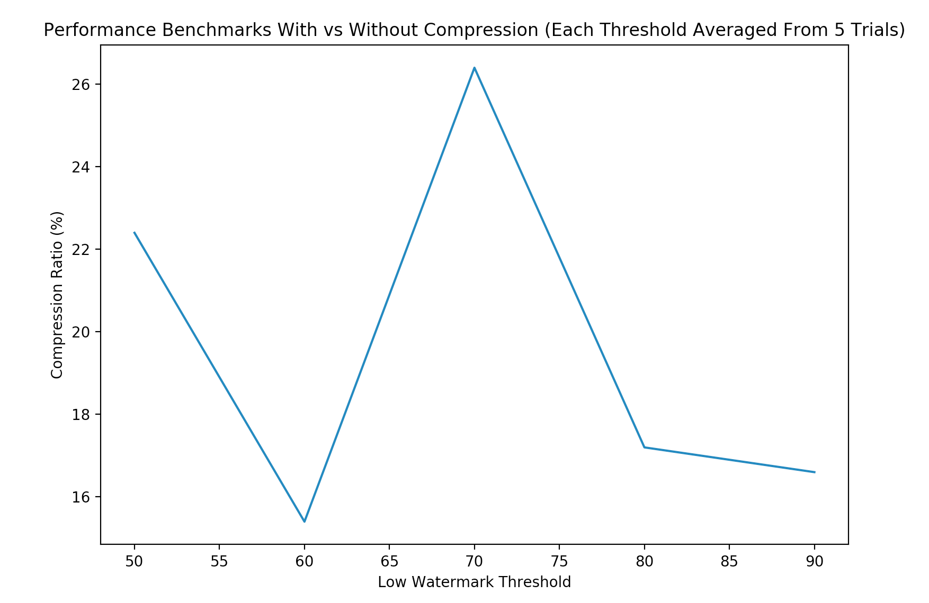
Benchmarking Results for low watermark threshold of 50, 60, 70, 80, and 90%

Slide 29
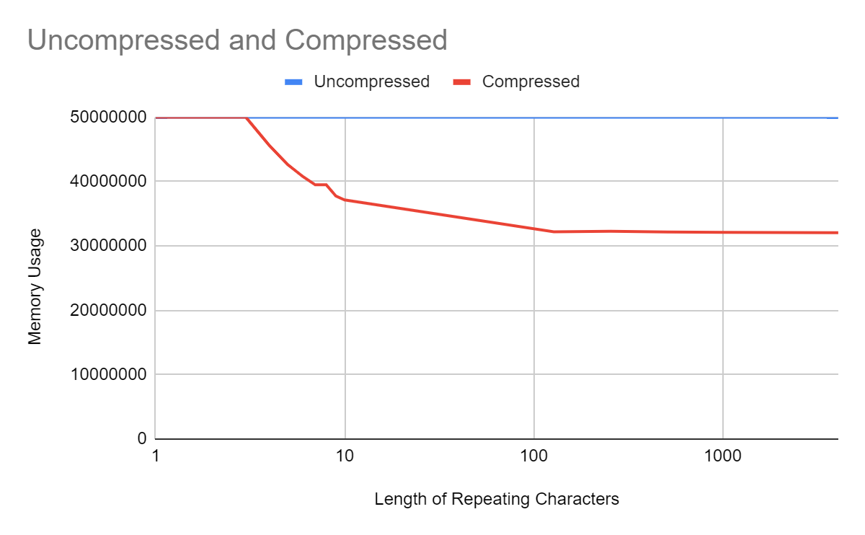
Repeating Data Graph vs Bytes Used
X-axis is how many characters are in a row in the data. More chars in a row means better compression.

Slide 30
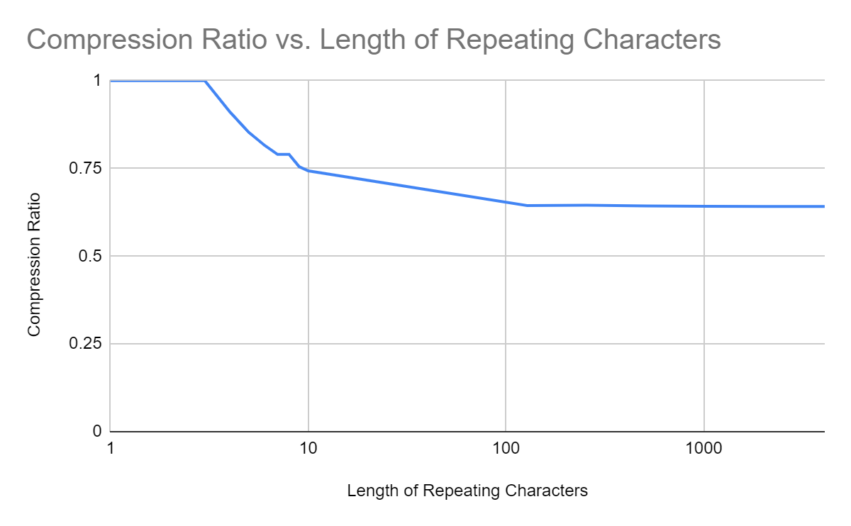
Repeating Data Graph vs Compression Ratio
X-axis is how many characters are in a row in the data. More chars in a row means better compression.

Slide 31
Real World Testing/Benchmarking:
Procedure: Install the device, run a load testing script to fill memory, open Firefox after 5 seconds. Wait until swap is filled up to 50 MB, then stop script and check results.
~ 18% compression during above testing.

Slide 32
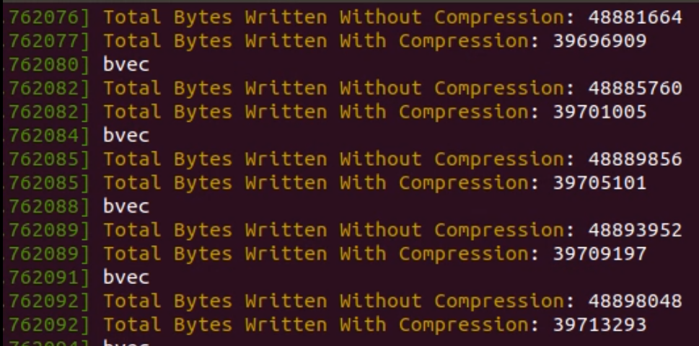
Example: Debug Output

Slide 33
Challenges

Slide 34
Working in the Kernel:
Debugging is much more difficult
Severe lack of *Recent Documentation
Literally the only kernel textbook
Written in 2005…
https://lwn.net/Kernel/LDD3/
Memory allocation decisions
Kmalloc() vs vmalloc()

Slide 35
Figuring out Current OS Implementations:
Figuring out the low-level functions of block device drivers, device partitions, swap file details.
Finding/Implementing compression in the kernel.

Slide 36
High Level Design:
Linked list vs block choice for data arrays.
Circular Array vs Not
Memory Overhead vs speed of lookup.
Avoiding Edge Cases

Slide 37
*Live* Demo

Slide 38
Bonus Content

Slide 39
Number of VM’s Destroyed this Semester: 268
Average Number of Make Warnings: 25
Number of Times I Asked Alex for a Debug Flag: 5
Number of Weird Bugs Discovered: 2

Slide 40

Our Faces When It Actually Worked
Priceless

Slide 41

Most Listened To Playlist
While “Working” Over Skype

Slide 42
